Slide 1
Part III
Notes:
Facilitator:
Part III of each module consists of outside resources that reflect the philosophy and values we are studying. For the hiring is the most important thing we wo philosophy we are using the book Good to Great by Jim Collins. A summary is available in the Resource Folder.

Slide 2
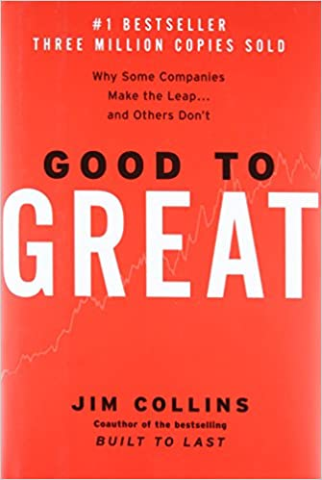
Chapter 3 Summary
Good-to-great leaders begin by first getting the right people on the bus.
The “who” question is answered before “what” decisions are made…
before vision,
before strategy,
before organizational structure,
before tactics.
The “failing” comparison companies frequently followed the “genius with a thousand helpers” model. The “genius” leader set the vision and then enlists highly capable “helpers” to make the vision happen. This model fails when the genius departs.
Good-to-great leaders are rigorous not ruthless in people decisions. They did not use lay-offs and restructuring as the primary means for performance improvement. Failing comparison companies used lay-offs to a much greater degree.
Three disciplines for being rigorous in people decisions:
When in doubt, don’t hire – keep looking.
When you know you need to make a people change, act. But first, make sure its not just a matter of them being in the wrong seat.
Put your best people on your biggest opportunities, not your biggest problems.
Good-to-great management teams consist of people who debate vigorously to get the best answers. Once debating is done, they unite behind the chosen decision regardless of their own interests.
Notes:
Script: Tiers I, II, III
Facilitator:
For us to demonstrate our belief around “life-long learning” it is important to explore resources that can challenge and expand our thinking. At Charge, one year, we all read Good to Great by Jim Collins. Collins studies companies from around the world and identifies the characteristics that make them an outstanding company. Much of what he has found can be applied to school systems. Chapter 3 (summary available in resource folder) of his book discusses the importance of getting the right people on the bus and in the right seat. As we dig deeper into the philosophy of hiring is the most Important thing we do, let’s look for connections between Collins’ book and our practices.
Before we read the summary let’s remember Collin’s book is over 20 years old and what we are examining are the practices of successful companies from that period. The question we must always ask is are these characteristics valuable in today’s world and the world of the future. Are they enduring characteristics? Let’s take 5 minutes to read the summary. Feel free to highlight connections to CUSD and/or components that resonate with you. For our next activities we will work in small job alike groups of 3 (facilitator’s choice based on participants).
Move to next slide.

Slide 3
First Who, Then What
“Get the right people on the bus,” is a concept developed in the book Good to Great. Those who build great organizations make sure they have the right people on the bus and the right people in the key seats before they figure out where to drive the bus. They always think first about who and then about what. When facing chaos and uncertainty, and you cannot possibly predict what's coming around the corner, your best "strategy" is to have a busload of people who can adapt to and perform brilliantly no matter what comes next. Great vision without great people is irrelevant.
Good to Great, Chapter 3
Notes:
Script: Tiers I, II, III
Facilitator:
Chapter 3 of the book, Good to Great, discusses the importance of getting the right people on the bus and in the right seat.
Read the excerpt on the slide. Facilitators choice of how to read.
Discussion Points:
In job alike groups discuss the following ramifications for CUSD hiring practices.
101 - Does the hiring structure help or hinder CUSD in becoming a great school district? Explain the positive aspects of the hiring process? Are there any challenges? What are they?
201 – Look at the fist paragraph on the slide. How does this paragraph apply to the hiring process at a school site or in a department.
301 – Read the second paragraph. What connections can you make between this paragraph and Clovis Unified? Explain your connection.
As groups finish their discussions ask each group to share their thoughts and connections.

Slide 4
You are who you hire…
How might you tell if someone is the right hire for Clovis Unified?
How might you tell if someone is struggling because they are not a “fit” for Clovis or possibly the position for which they were hired? They are simply in the wrong seat and not the wrong person on the bus entirely?
Think of a case where you had doubts, but you hired anyway. What was the outcome? Why did you make the recommendation, if you had doubts? What do you learn from the situation?
If compensation is not the primary driver for the right people on the bus, then what are the primary elements in getting and keeping the right people on the bus? What role does compensation play?
Notes:
Script: Tiers I, II, III
Facilitator:
The questions on the screen are from a study guide provided by Collins for his book Good to Great. Let’s take a little time to think about each question and how it relates to your job as a leader in Clovis Unified. Ask participants to number off 1, 2, 3, 4. Participants should sit with their number group. As a group they will answer the assigned question.
Discussion Points:
Your group will discuss and answer the question you were assigned. Each group will share their answers. Please be specific, use examples, and relate to your role as a leader in our district. Facilitator should demonstrate the depth of conversation that should take place. Example: If the response to why someone is the right fit is “they care about kids” the facilitator would ask what did they say/do that tells you they care about kids?
As groups finish their discussions ask each group to share one or more of their responses (facilitator’s choice).

Slide 5
Rigorous not Ruthless
Good-to-great leaders are rigorous not ruthless in people decisions. They did not use lay-offs and restructuring as the primary means for performance improvement. Failing comparison companies used lay-offs to a much greater degree.
Good to Great, p. 63
Notes:
Script: Tiers I, II, III
Facilitator:
CUSD does not lay-off full time employees. When budget reductions are necessary decisions have been made with the purpose of keeping the “cuts” away from students.
Discussion Points:
In small job alike groups discuss one or more of the following:
101 – Why would a company avoid lay-offs and restructuring? Use examples to explain your thinking.
Possible answers: employee morale, overload for remaining employees, creating an us against them mentality
201 – According to Collins “to be ruthless means hacking and cutting, especially in difficult times, without thoughtful consideration.” Rigorous means consistently applying exacting standards at all levels, especially in upper management.” How can the term rigorous be applied to CUSD during financially “tough times”?
Possible answers: consider core philosophies and values when making decisions, debate possible solutions
301 - Generate a list of possible solution rather than lay-offs. What are the positive and negative aspects of each? Be specific and use examples.
The following are examples of what CUSD has done in the past:
GIS shared between two schools
Not replacing an open position
All employees take one or more furlough days
A salary reduction shared by everyone
Reassigning staff from curriculum support positions back to school sites to fill vacancies
As groups finish their discussions as them to share their answers with the larger group.

Slide 6
“Be rigorous in people decisions.”
When in doubt – don’t hire. Keep looking.
When you know you need to make a people change, act.
Put your best people on your biggest opportunities, not your biggest problems.
Good to Great, p. 63
Notes:
Script: Tiers I, II, III
Facilitator:
We just discussed the differences between the words rigorous and ruthless. Let’s look at examples of rigor when discussing decisions that involve people as defined by Collins in his book Good to Great.
Discussion Points:
In a small job alike groups of 3 think about decisions you make, as a leader, that impact people. Thinking about the key concept “being rigorous in people decisions”. Discuss one or more of the following (facilitator’s choice):
101 – Have each person in the small group choose one of the concepts on the screen and provide an example of that concept in action. Select one answer to share with the large group.
201 – How can the concept “when in doubt – don’t hire” be implemented? Have you ever not hired? Discuss what you did instead. What were the positive and/or negative consequences of your decision? Select one answer to share with the large group.
301 – Think about putting your best people on your biggest opportunities, not your biggest problems. What does that look like in practice? What are the advantages? Are there any disadvantages? Be specific and use examples. Select one answer to share with the large group.
As groups finish their discussions ask them to share one response with the larger group.

Slide 7
Debate rigorously…
Good-to-great management teams consist of people who debate vigorously to get the best answers. Once debating is done, they unite behind the chosen decision regardless of their own interests.
Good to Great, p. 63
Notes:
Script: Tiers I, II, III
Facilitator:
A leader I admire once told me that my job was to give him my best thinking. Another one once told me “don’t bring me problems bring me solutions”. In cabinet meetings at the site and department our bosses need our best thinking. If they have done a good job of hiring, each of us brings a unique perspective to the situation that needs to be heard. Let’s look a little more deeply at the quote from Good to Great. Ask a participant to read the quote.
Discussion Points:
Turn to a neighbor and answer one or more of the following (facilitator’s choice).
101 – Why is it important that the management team to debate? What happens if there is no debate? What are some reasons someone might not be willing to debate an issue?
Possible answers: fear, no guarantee they will be heard, lack of trust, lack of respect
201 – What would you do if after debating the issue you vigorously disagreed with the decision that was made? Explain your thinking.
301 – If a decision cannot be debated, for instance whether our students will participate in state testing, what can and should be debated? What is the purpose of debating a mandate?
Possible answers:
How are we going to make sure our students are successful on state testing?
What supports do our students need?
What accommodations can we make to support our students?
Which ear buds work the best and are of greatest value?
As partners finish their discussion ask for volunteers to share their thoughts. Allow time for questions and feedback.

Slide 8
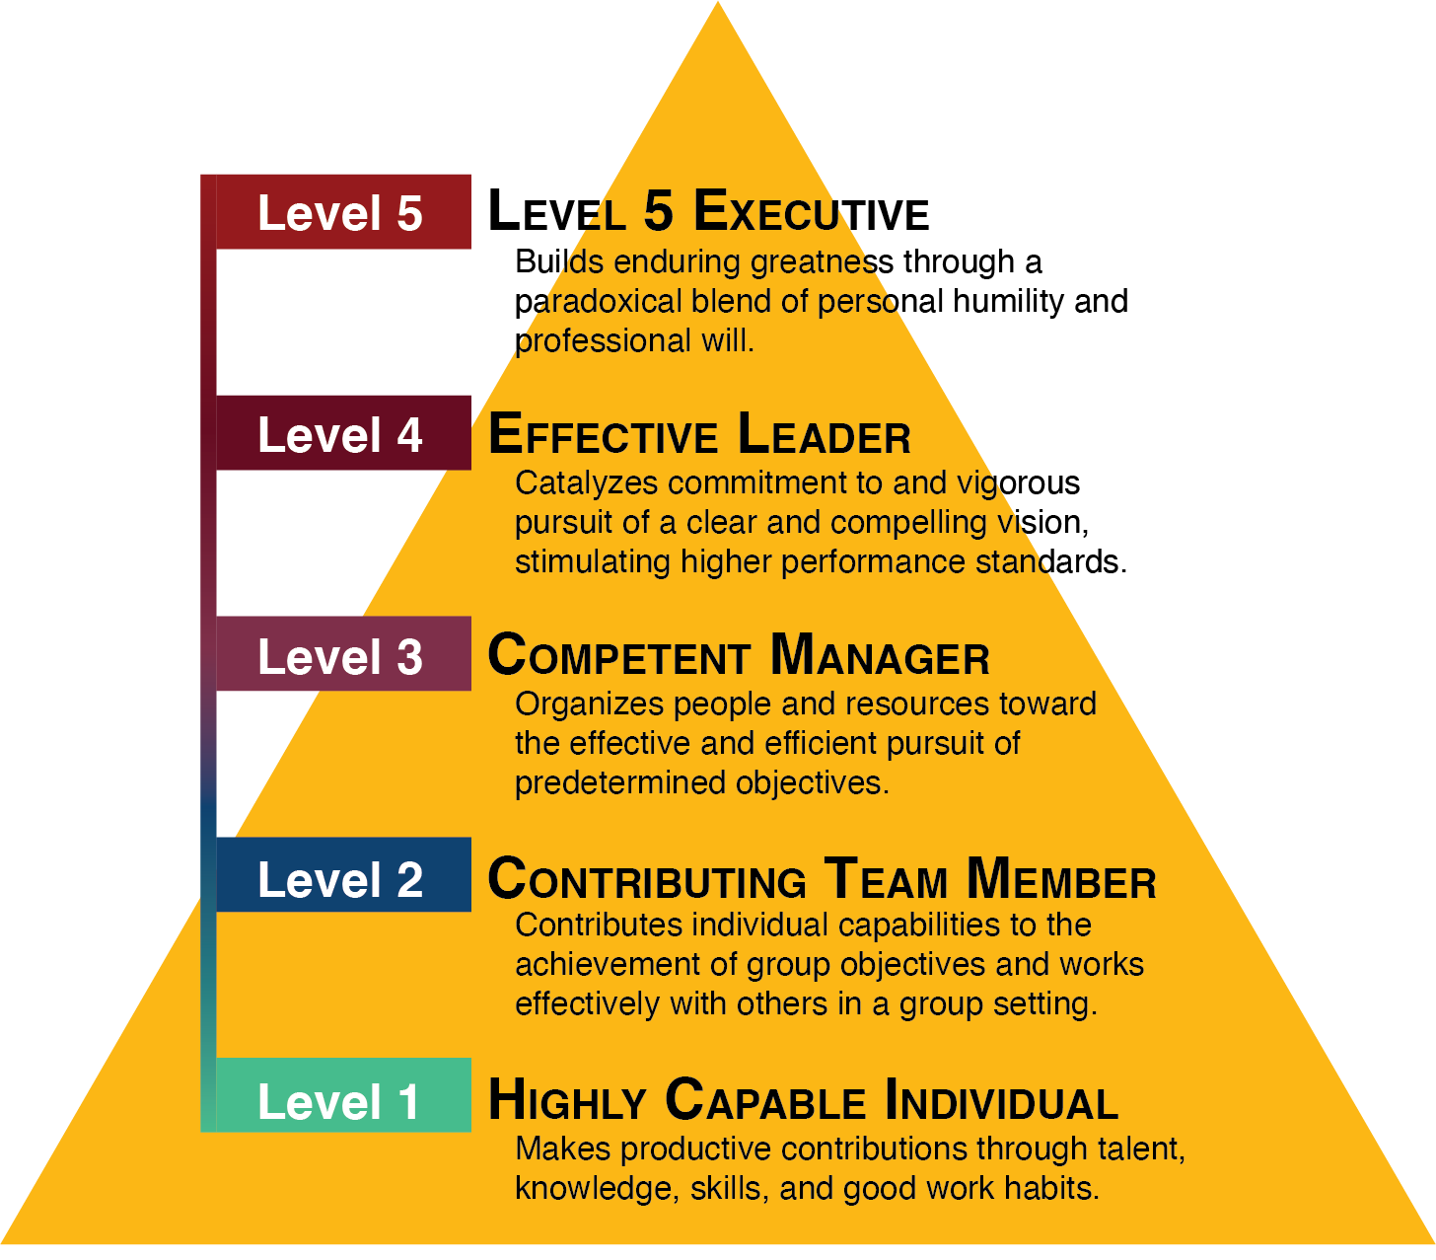
Good to Great, p.20
Notes:
Script: Tiers I, II,
Facilitator:
According to Collins Level 5 leaders display a powerful mixture of personal humility and indomitable will. I strive to be a level 5 leader but let’s face it there is always room for improvement, right? That’s part of my personal growth and development as a leader. Every module provides an opportunity for us to look at our own leadership. We can examine where we are, what we do well, and where we have room to grow. Let’s look at the leadership hierarchy provided by Collins on page 20 of Good to Great (available in resource folder). Ask participants to gather in job alike groups of three.
Discussion Points:
Before we place ourselves on the Leadership hierarchy let’s look at each level.
101 - Think about someone you consider to be a Level 5 leader. What are some examples of the things he/she does that make them a Level 5 leader?
201 – Let’s examine each level. Notice that Collin’s model is a ladder, something leaders can climb to reach the highest level. It provides a way to monitor continuous improvement. Think about the employees in your school/department and where they fall within this hierarchy. Use examples to support your thinking. What would they need to do to become a level 5 leader? Be specific and use examples.
301 - Now, think about yourself as a leader. Where would you place yourself and why? What do you need to accomplish to rate yourself as a Level 5 leader? If it is a safe environment, you may share with members of the triad (facilitator’s choice). If not, ask participants to individually record their answers and share with a trusted mentor for feedback.
As triads complete their conversations ask them to share their answers.

